Slide 1
Modèle de Kano
Satisfaction
Exciters
Performance
Présence fonctionnalité
Basics

Slide 2
Le processus de responsabilité
Responsibility
Obligation
Shame
Justify
Lay Blame
Denial
Quit
Source: Christophe Avery, conseiller sur le leadership responsible et le travail de groupe
Notes:
Responsibility Owning your ability and power to create, choose, and attract
Quit Giving up to avoid the pain of Shame and Obligation
Obligation Doing what you have to instead of what you want to
Shame Laying blame onto oneself (often felt as guilt)
Justify Using excuses for things being the way they are
Lay Blame Holding others at fault for causing something
Denial Ignoring the existence of something

Slide 3
Six simple KPIs
Innovation Rate
Strategic Alignment Index
On-Product Index
Product Availability
Usage Index
Installed Version Index

Slide 4
Innovation Rate
Building new vs. sustaining existing
What percentage of your product is spent on
building new functionality
vs. maintaining the existing
vs. expanding capacity?

Slide 5
Innovation Rate
Which is better ?

Slide 6
Strategic Alignment Index
Software to support strategic vision and IT strategy
High
Highest benefits are most likely realized when building these products or features
Business Strategic Alignment
= Product
Size of Bubble = TCO
Low
Low
IT Strategic Alignment
High

Slide 7
Strategic Alignment Index
High
Highest benefits are most likely realized when building these products or features
Business Strategic Alignment
= Product
So why do these get built ?
Size of Bubble = TCO
Low
TCO (Total Cost of Ownership) and alignment are some variables that can be used in backlog ordering
Low
IT Strategic Alignment
High

Slide 8
On-Product Index
Making sure team can deliver
Percent of time team spends working on product stuff
(eg. Things that create value)
Generally, higher is better

Slide 9
Task switching destroys efficiency and quality, and can actually make you less intelligent
Source: Gerald Weinberg, Quality Software Management : System Thinking

Slide 10
Product Availability
Customer access, usability, and support
Product Availability
Product Performance
Support Execution
Operational Excellence

Slide 11
Usage Index
Do people actually use the functionality you build ?
Build things that people will actually use.
If they aren’t, try to figure out why and drive more usage. If you can’t, why do you have the feature ?
Higher tends to be better

Slide 12
Installed Version Index
Monitoring product absorption
What percent of your customers are on your latest (n) release ?

Slide 13
Any KPI by itself provides very little information.
KPIs are all interconnected
Innovation Rate
Strategic Alignment
On-Product Index
Availability Index
Usage Index
Version Index

Slide 14
Using KPIs provides a high-level proxy of actual value delivered by software products
Innovation Rate
Strategic Alignment
On-Product Index
Availability Index
Usage Index
Version Index
$1
29%
50%
80%
99%
35%
70%

Slide 15
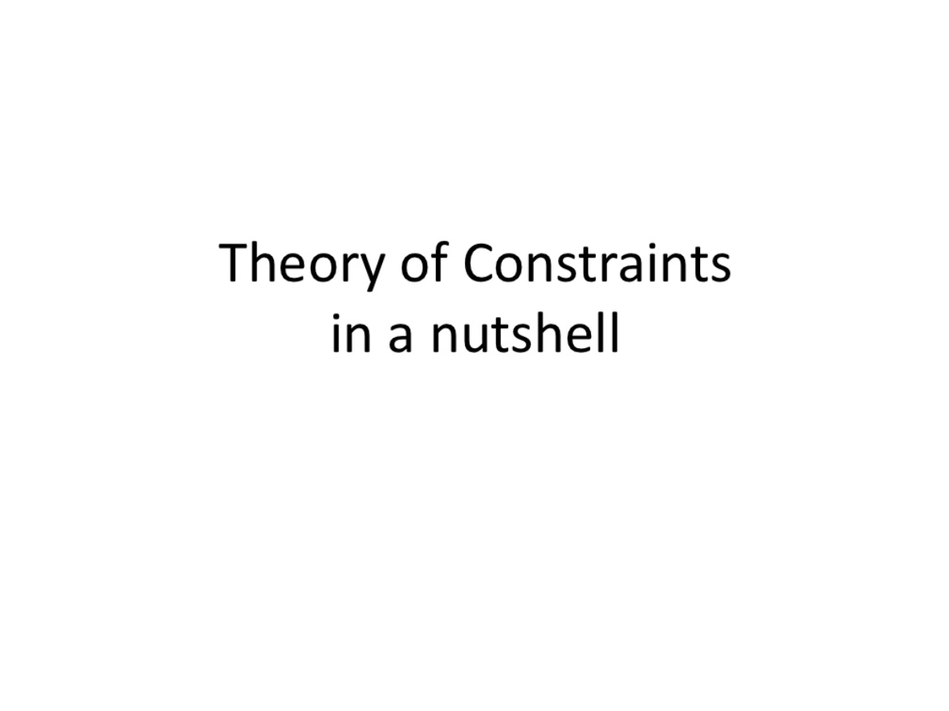

Slide 16
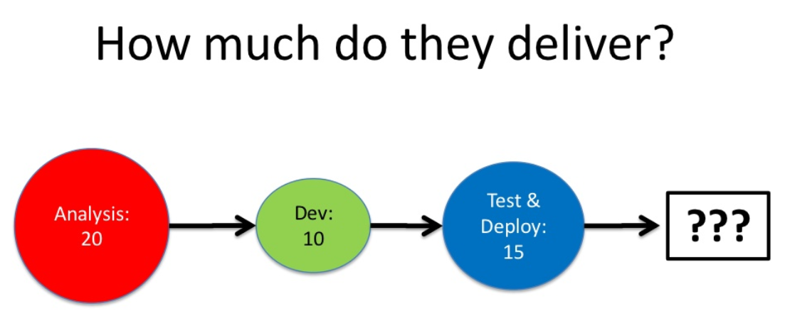

Slide 17
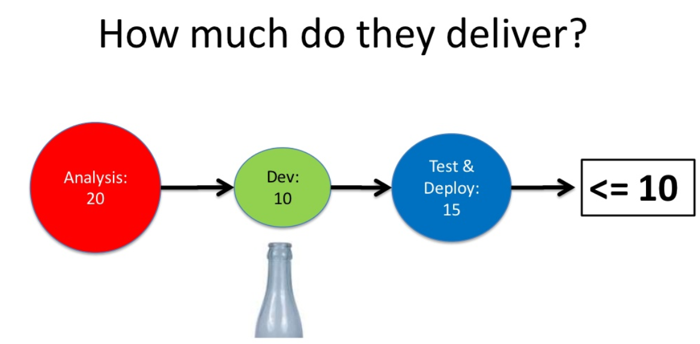

Slide 18
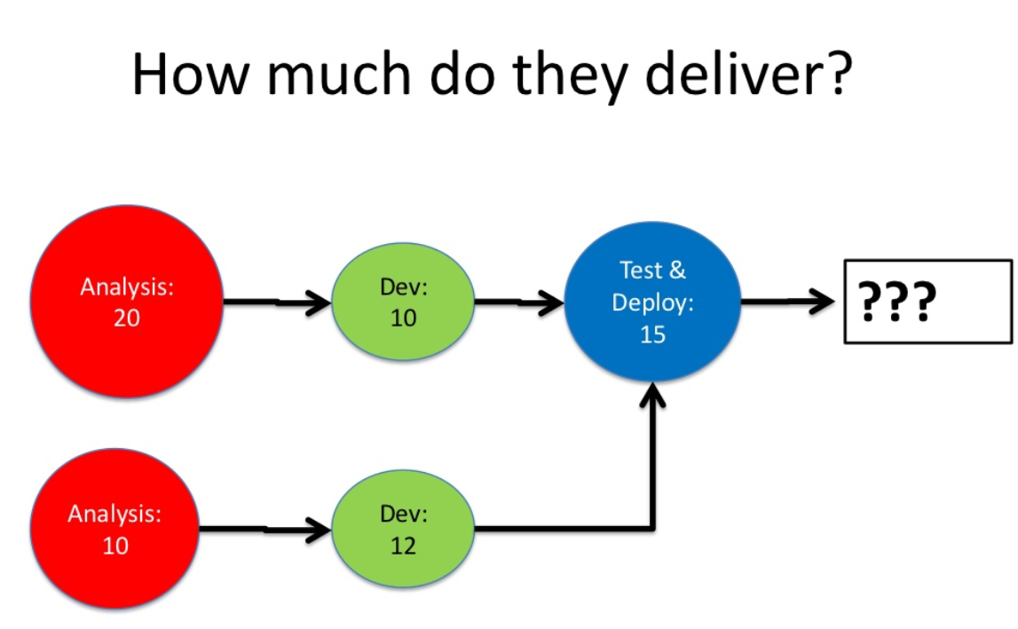

Slide 19
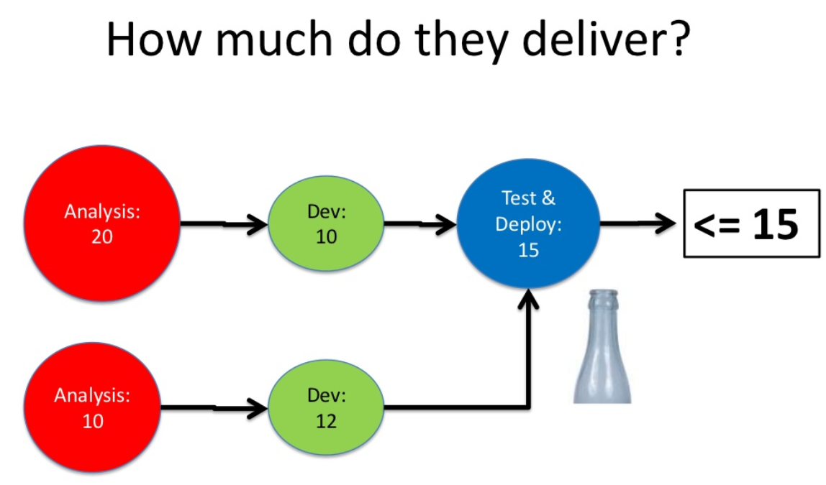

Slide 20
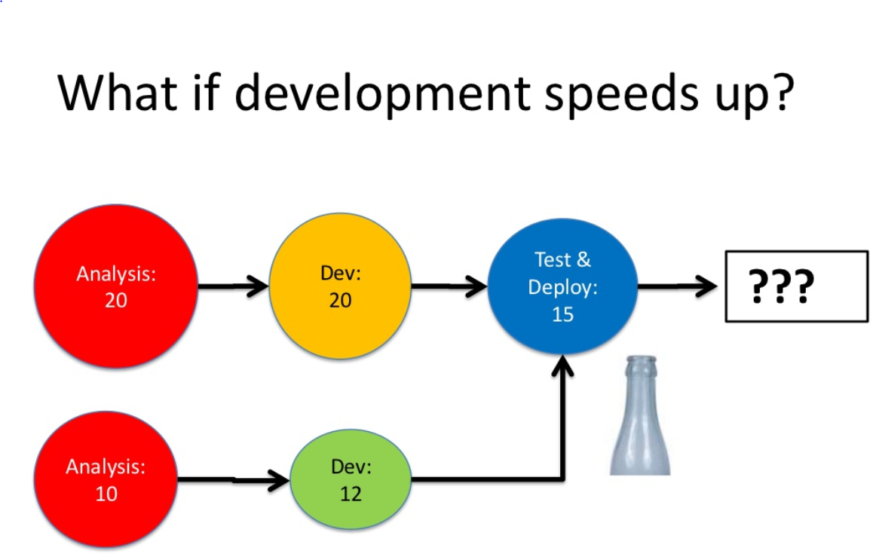

Slide 21
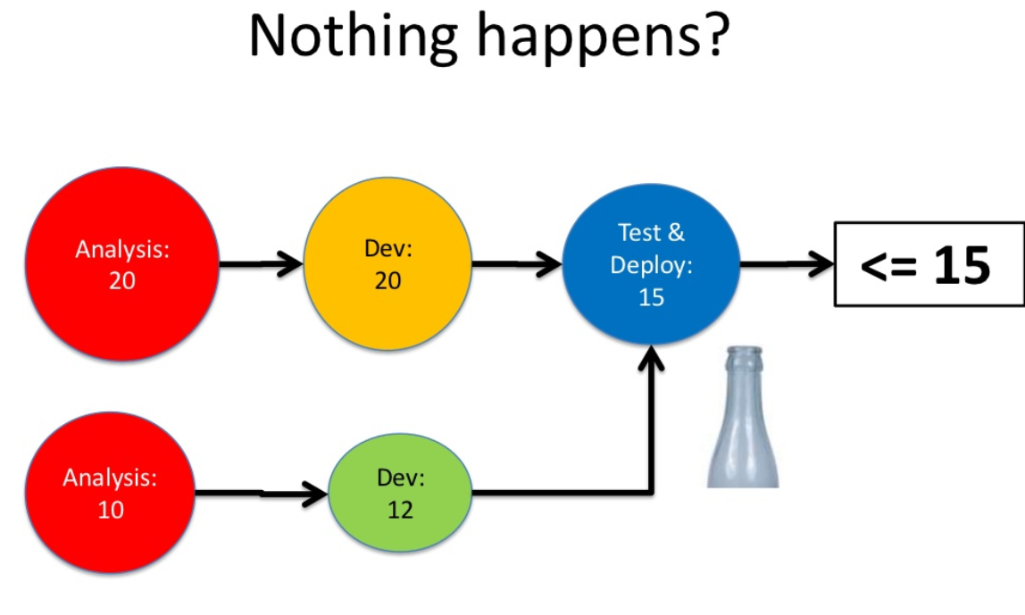

Slide 22
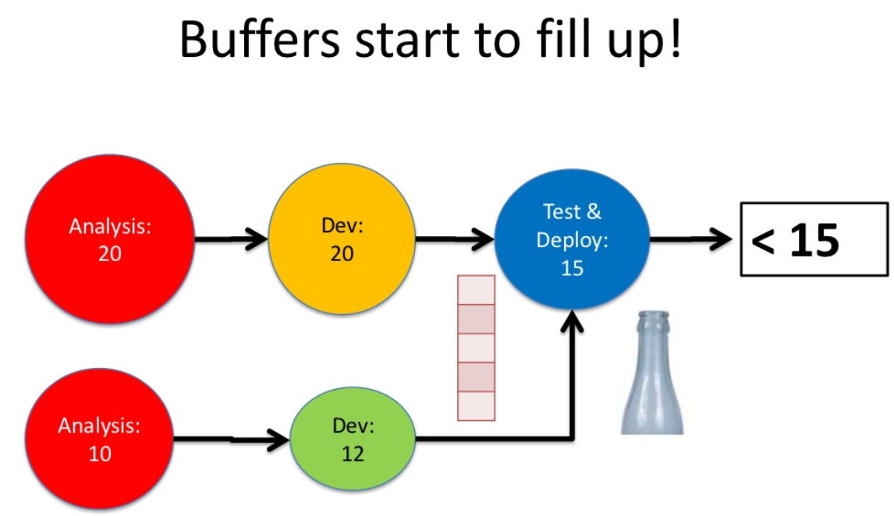

Slide 23
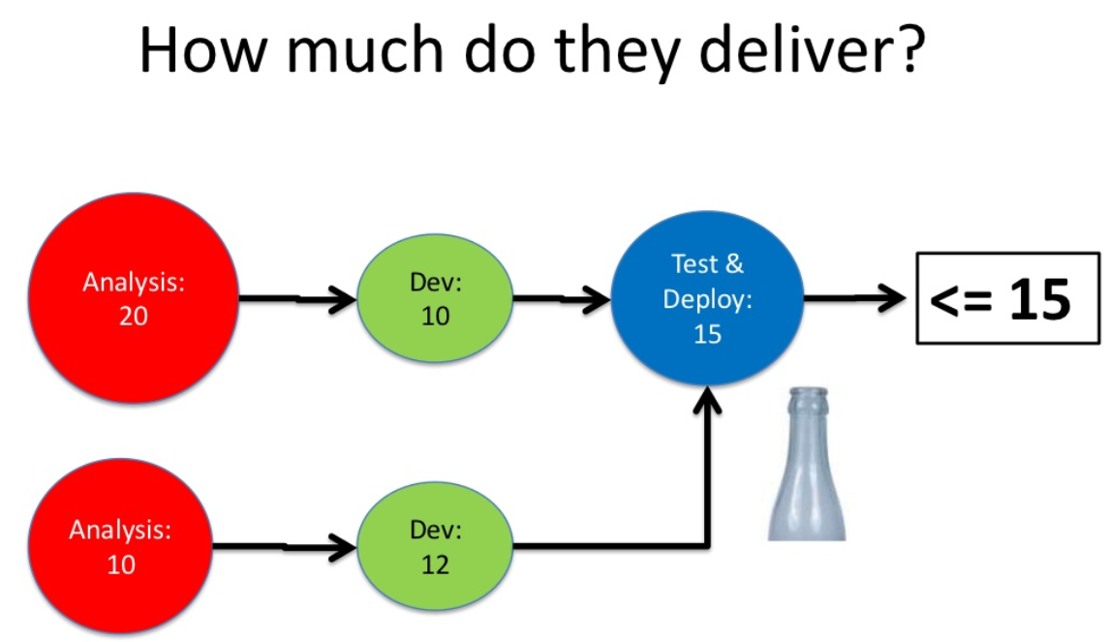

Slide 24
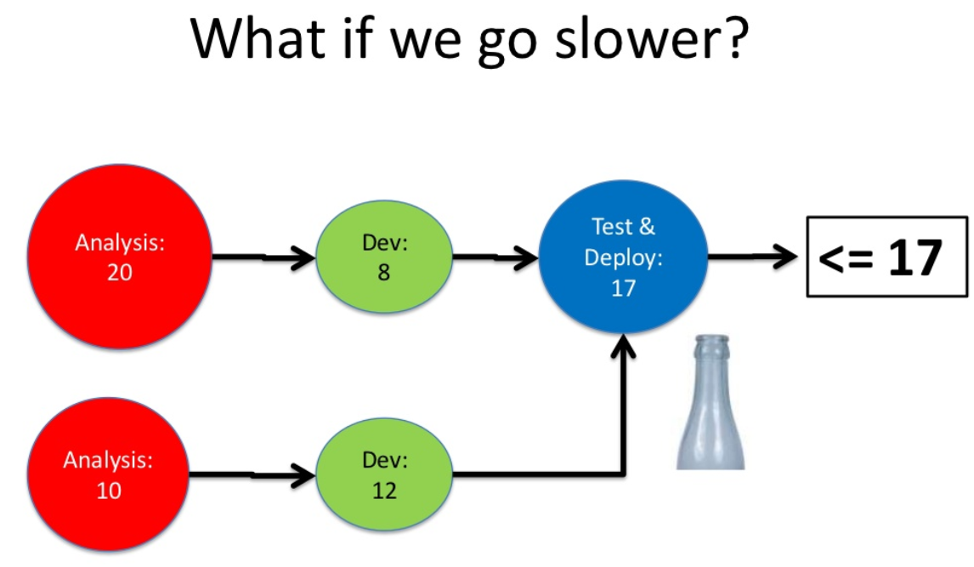

Slide 25
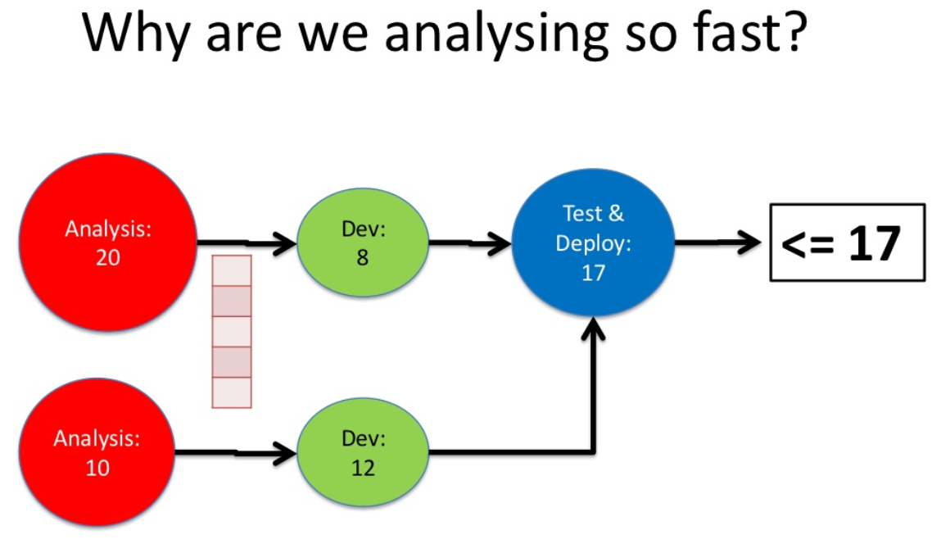

Slide 26
