Slide 1

The Agile Projects
Pierre-Emmanuel Dautreppe
Norman Deschauwer

Slide 2

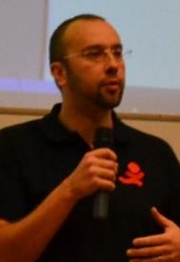
Who are we?
Pierre-Emmanuel
Dautreppe
Norman
Deschauwer
.NET Architect
Coach & Trainer
Scrum Practitioner
Manager 3.0

Slide 3
Agenda
Origin of Agile methodologies
Why are we doing agile?
Some examples of agile methodologies
Presentation of eXtreme Programming
  The 5 values
  The 13 practices
Let’s practice XP!

Slide 4

The origin of Agile Methodologies
1962
1999
2001
XP
Scrum
agilemanifesto.org
Agile Manifesto

Slide 5
Manifesto for Agile Software Development
We are uncovering better ways of developing
software by doing it and helping others do it.
Through this work we have come to value:
Individuals and interactions over processes and tools
Working software over comprehensive documentation
Customer collaboration over contract negotiation
Responding to change over following a plan
That is, while there is value in the items on
the right, we value the items on the left more.
http://www.agilemanifesto.org

Slide 6

Agile objectives
Cost reductions
Answer stricly to the needs
(no more, no less)
Reduce bugs
No tunnel effect

Slide 7


Agile Objectives
Avoid failures
$$Every project=Success$$

Slide 8

Agile objectives
Maximize business value
Listen to client needs
Answer to operational constraints
Quick return on investment

Slide 9
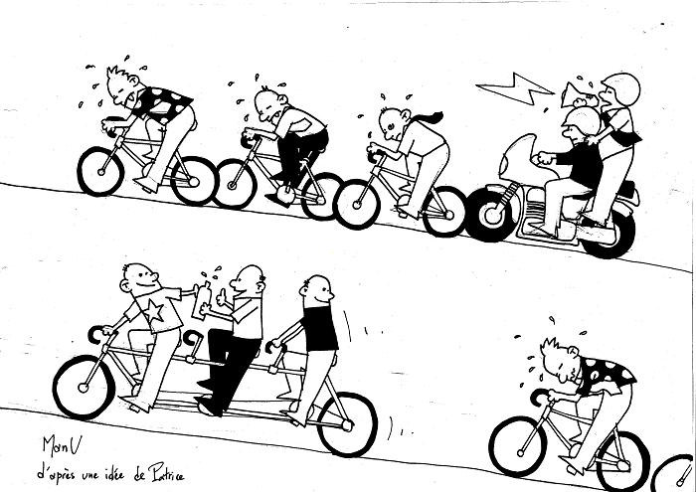
A new way of working
D’après un article d’E. Chenu
From Emmanuel Chenu

Slide 10
Adapt hierarchy
Client Side
Supplier side
« Project »
Project Manager
Analyst
Client
Developer
Tester
Director
Department Head
Department Head
Employee 1
Employee 2
Employee 3
Employee 4
Project Manager
Department Head
Project Manager
Analyst
Architect
Technical Lead
Dev. 1
Dev. 2

Slide 11
The difficulties met when
setting up agility
always reflect the organization incapacity to cope with
its internal conflict
Jean-Pierre Vickoff

Slide 12
Some example of agile methodologies
Agile
Scrum
XP
And many more
LEAN
RAD
Feature Driven Development
DevOps
Adaptive Software Development
Crystal Clear
PUMA

Slide 13
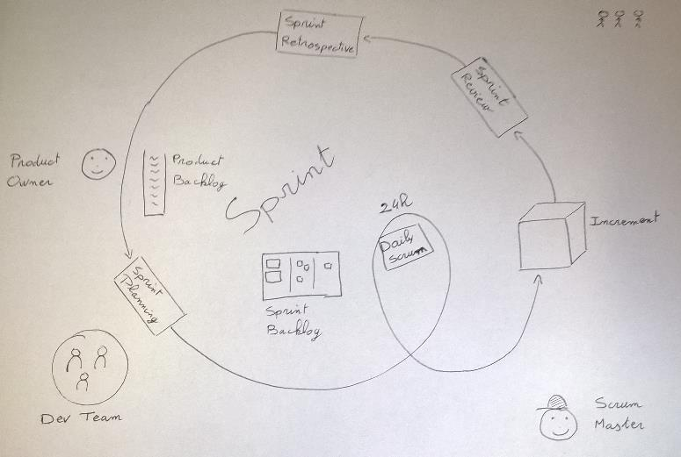
Scrum – In 1 Slide
3 roles
5 events
3 artifacts

Slide 14
eXtreme Programming
The theory

Slide 15
The 5 values
Communication
Respect
Feedback
Courage
Simplicity

Slide 16
13 Practices
Organization
Planning Game
Whole Team
Sustainable Pace
Communication / Feedback
System Metaphor
Small Releases
Stand up Meeting
Technical Organization
Coding Standards
Code Collective ownership
Pair Programming
Development
Simple Design
Refactoring
Continuous Integration
Testing
Unit Tests
Acceptance Tests

Slide 17
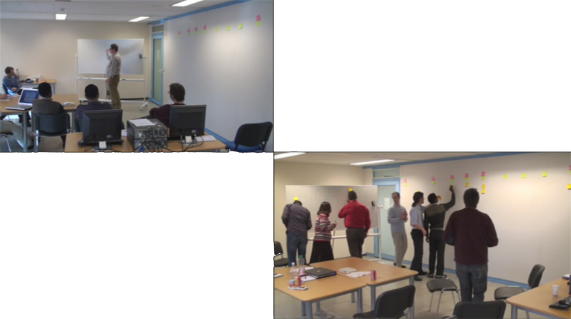
Organization practices
Organization
Planning Game
Whole Team
Sustainable Pace
What « done » means ?

Slide 18

Organization practices
Organization
Planning Game
$$Whole Team=\left\{\begin{aligned}Developers \\ Analysts \\ \begin{matrix}Testers \\ Clients\end{matrix}\end{aligned}\right.$$
Whole Team
Sustainable Pace

Slide 19
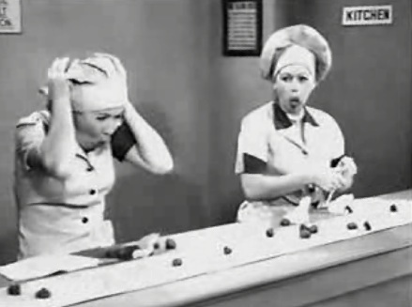
Organization practices
Organization
Planning Game
Whole Team
Sustainable Pace
« I Love Lucy »
Notes:
Serie « I Love Lucy » :
Ellen & Lucy have been hired in a chocolate factory and tries to do whatever possible to follow the factory pace

Slide 20
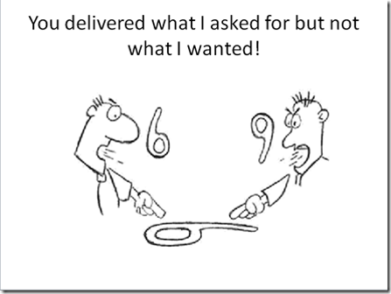
Communication / Feedback
Communication / Feedback
System Metaphor
Small Releases
Stand up Meeting

Slide 21
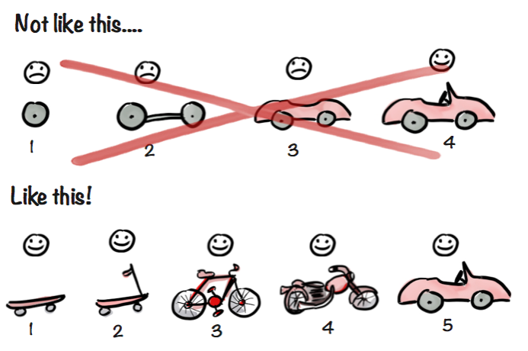
Communication / Feedback
Communication / Feedback
System Metaphor
Small Releases
Stand up Meeting

Slide 22
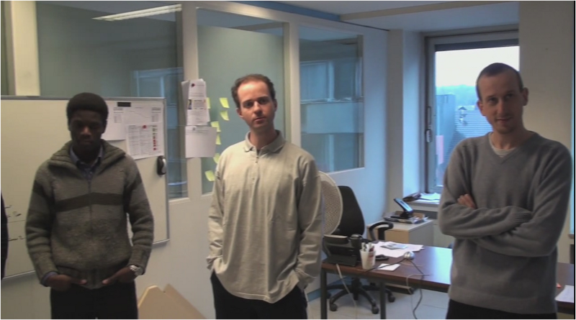
Communication / Feedback
Communication / Feedback
System Metaphor
Small Releases
Stand up Meeting
Which impediment I have met?
What I have done?
What will I do?

Slide 23
Technical Organization
Technical Organization
You don’t want to know who write what
Anyone can modify the code
Any code looks like to any other code
Coding Standards
Code Collective ownership
Pair Programming

Slide 24
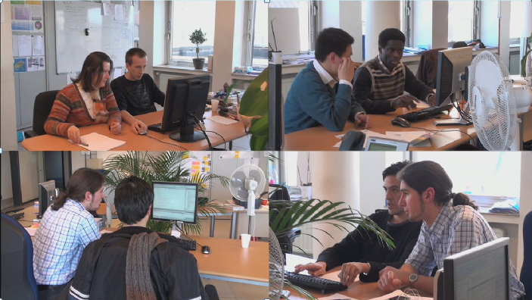
Technical Organization
Technical Organization
Coding Standards
Code Collective ownership
Pair Programming

Slide 25


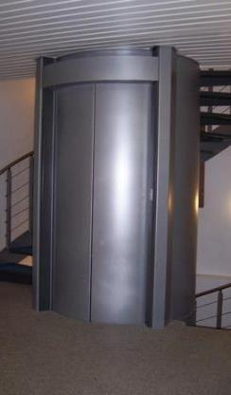
Development
Development
Simple Design
Refactoring
Continuous Integration

Slide 26
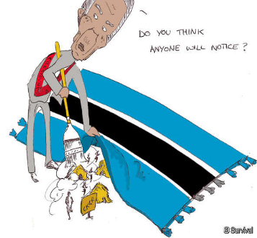

Development
Development
Simple Design
Refactoring
Continuous Integration

Slide 27
Development
Development
Simple Design
Pair A
Build
Refactoring
Continuous Integration Server
Continuous Integration
Pair C
Pair B
Report
Compil OK
Test 1
Test 2
Test 3
…..
Test N

Slide 28
Testing
Write a test
The test does not compile
Write the corresponding API
The test fails
Write the code
The test passes
Clean the code
Unit Tests
Test Driven Development Cycle
Acceptance Tests

Slide 29
Extreme Programming
Let’s practice :
The XP Game

Slide 30
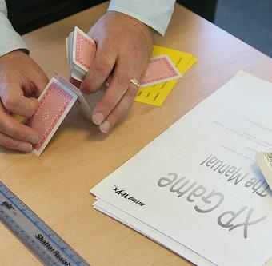
XP Game

Slide 31
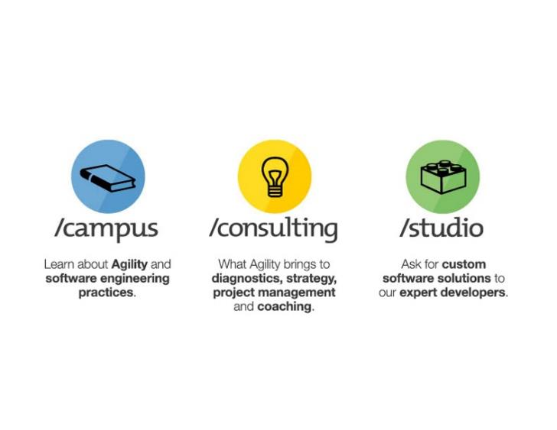

Questions
Thank you!
pyxis-tech.com

