Slide 1
TDD by example
Pierre-Emmanuel DAUTREPPE – October 26th 2012
Why shall we test ?
What is TDD (Test Driven Development) ?
Let’s practice it together doing a kata...

Slide 2




Pierre-Emmanuel DAUTREPPE
« .NET Architect » and « XP Coach »
Founder of
  User Group « DotNetHub »
  « La Journée Agile »/« Agile Tour Namur »
Me contacter via :
  pierre@dotnethub.be
  http://www.pedautreppe.com
  http://www.dotnethub.be
  @pedautreppe

Slide 3

Our developer life
We are genious ! (generally misunderstood)
We = developers
commented it
documented it
Turk et De Groot
That functionality you implemented, you have ?
No, that’s useless ! It’s trivial !
…
…
… doesn’t work …
????
tested it
n00b
Notes:
What is really trivial ?
Trivial for who ? Et for how long ?

Slide 4
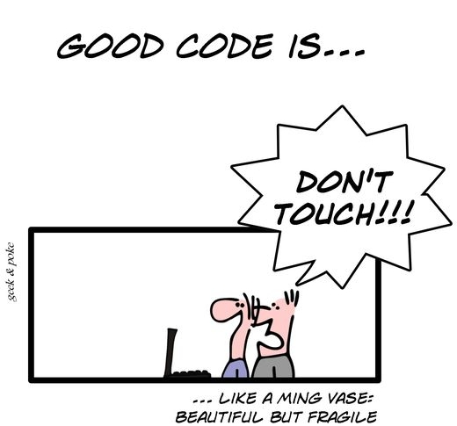
Our developer life
Notes:
Have you already worked in a maintenance project (written by another company) ?
We do not know all the business rules
We do not know the code
We are over-using copy & paste, being afraid of breaking stuffs
And if we break something, how long it takes us to be aware of that ?

Slide 5

Our developer life
Just use a safety net !
Pinder Circus

Slide 6
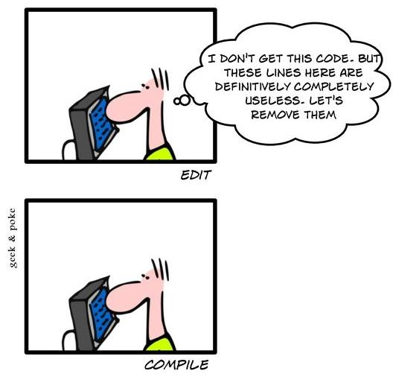
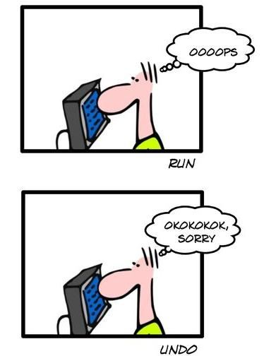
Tests are a validation tool…
Notes:
Validate the behavior of code against :
The developper intent
The client wish
Security net → against regression

Slide 7
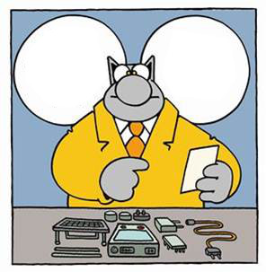
…but also a documentation tool…
It’s written
« Sort out
your own problems ! »
Here is a pretty clear user manual
Notes:
Tests give us :
Example of how to use the code
Code specifications (limit use, examples, …)
Client specifications (how a functionality is meant to be used)

Slide 8
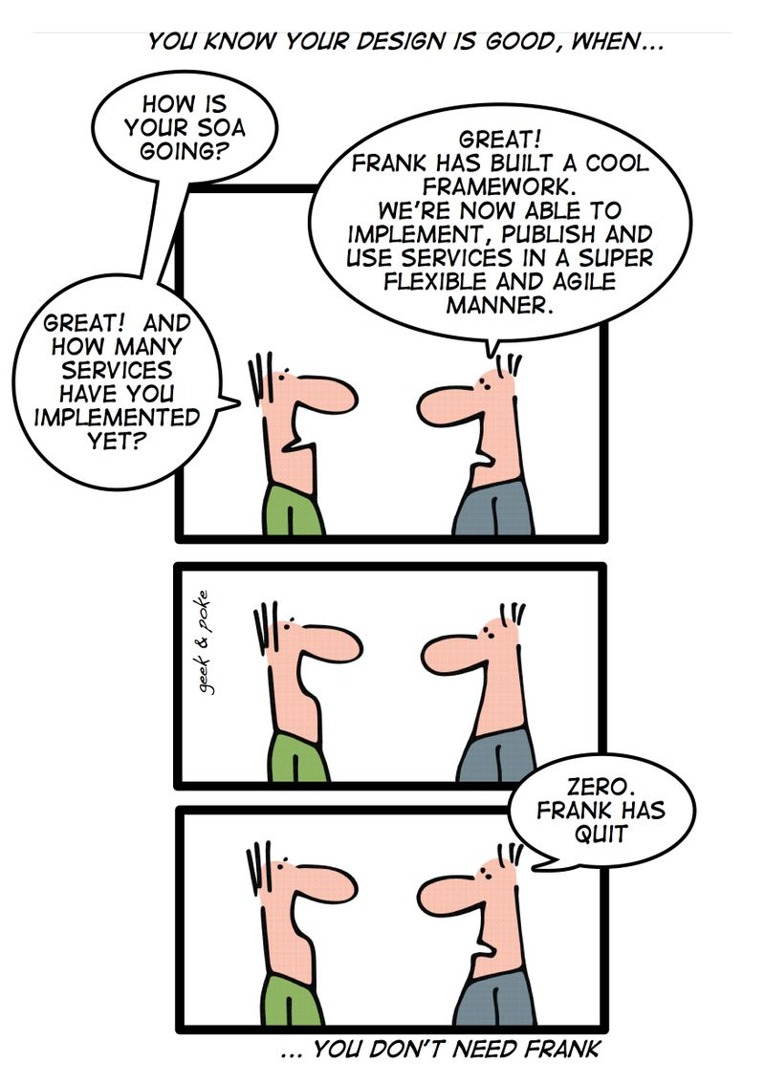
…and a design tool
Notes:
We are the first user of our code
We write simpler code
We define simpler APIs

Slide 9


The « Test Driven Development » Cycle
Write a test
Refactoring of tests
Refactoring
It does not compile
Refactoring of code
Test passes
Write needed API
Implement
Test compiles
but fail
Notes:
TDD brings
A real design tool
Forces to simplify code (take baby steps)
Beware of « False Positive »
Cycle of refactoring : do not refactor « code and test » at the same time → Each one plays the role of a safety net for the other one

Slide 10
Code coverage, myth or reality ?
« Complexity » and « code coverage »… what’s that ?
string ReadFooValue()
{
string[] lines = File.ReadAllLines(@"c:\myapp.ini");
foreach ( var line in lines )
{
int index = line.IndexOf('=');
string name = line.Substring(0, index);
if ( name.StartsWith("Foo") )
{
string value = line.Substring(index + 1);
return value;
}
}
return null;
}
Notes:
Complexity :
Number of possible paths in a code (1 by default)
In a sense « equivalent » to the number of test needed to « cover a method »
Code coverage
Percentage of code blocks where at least one test goes thru

Slide 11
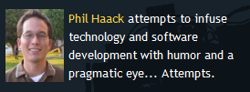
Code coverage, myth or reality ?
100% code coverage
is not enough !
Phil Haack
Notes:
What shall be a correct goal ?
For Microsoft, 80% is something realistic
In agile community, there is one consensus : « If your code coverage ratio is low, that’s a bad smell. If it’s high… well… we can’t say anything… »
To remind:
Why less than 100%
There is useless generated code
Why more than 100%
Code coverage does not take into account the number of assertions !
Shall not be a goal for itself, does not guarantee that all features are implemented

Slide 12






Improve the feedback
Release
Bugs cost
Test
Development

Slide 13


Slide 14
Conclusion
TDD let you use tests as
  A validation tool
  A documentation tool
  A design tool
Follow the TDD rules
  Be iterative: split your work in small (requirement) increments
  Always start by writing a test
  Then implement untill the test passes
  And Cleanup! (refactor)

