Slide 1


Managed Extensibility Framework
Georges Legros
@georgeslegros

Slide 2
Agenda
Introduction
MEF vs DI
Basic Import / Export
Instance management
Metadata
Dynamic Composition
Extensibility

Slide 3

Managed Extensibility Framework
The Managed Extensibility Framework (or MEF for short) simplifies the creation of extensible applications. MEF offers discovery and composition capabilities that you can leverage to load application extensions.
http://mef.codeplex.com

Slide 4
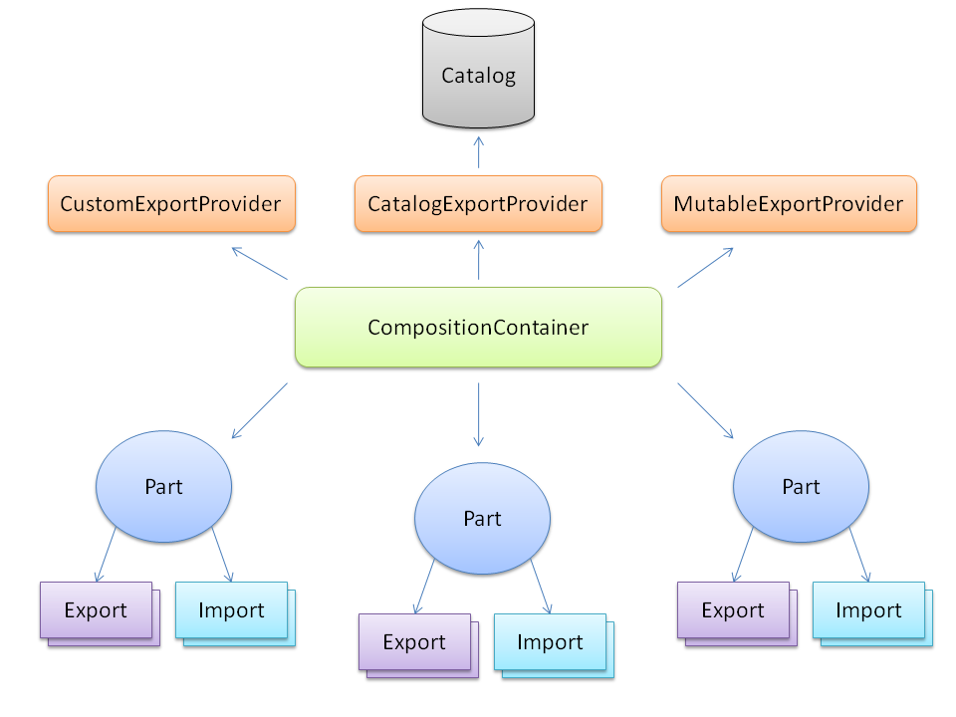

Slide 5
MEF vs DI
Extensibility / plug-in
Discovery
Metadata for querying and filtering
Recomposition

Slide 6
MEF vs DI
DI/IoC containers focus on those things you know where MEF focuses on those things you don't…
I know I will use one logger in a Unit Test, and a different Logger in my app
Vs
There are 1 to n loggers that may appear in my system

Slide 7
Basic Import / Export
Step 1: Declare a « Contract »
  Interface
  String
  Both
Step 2: Import / ImportMany
Step 3: guess what… Export

Slide 8
DEMO 01
Managed Extensibility Framework

Slide 9
Instance Management
PartCreationPolicy
  Shared
  NonShared
  Any (WTF ???)
    Default: Shared
[PartCreationPolicy(CreationPolicy.Shared)]

Slide 10
DEMO 02
Managed Extensibility Framework

Slide 11
Instance Management
Lazy<T>
  Instance created on demand
ExportFactory<T>
  Creation of a fresh instance each time
  Silverlight only
  Will integrate desktop in V2

Slide 12
DEMO 03
Managed Extensibility Framework
& 03_2

Slide 13
Metadata
Lazy<T>
  Instance created on demand
ExportFactory<T>
  Creation of a fresh instance each time
  Silverlight only
  Will integrate desktop in V2

Slide 14
DEMO 04
Managed Extensibility Framework

Slide 15
Metadata (2)
Evil strings are EVIL
Solution -> Custom Export
Advantage:
  Strongly typed
  Less error prone
  Easy to discover all possible metadata properties
Disadvantage
  Have to share some code with clients

Slide 16
DEMO 04_2
Managed Extensibility Framework

Slide 17
Dynamic Composition
Desktop app
  AssemblyCatalog
  DirectoryCatalog
  Can load multiple time
  Can unload

Slide 18
DEMO 05
Managed Extensibility Framework

Slide 19
Dynamic Composition
Silverlight
  Deployment Catalog
  Download Progress
  Download Completed
  Auto download
  Relative path

Slide 20
DEMO 06
Managed Extensibility Framework

Slide 21
Extensibility
2 ways to extend MEF
  ExportProvider
  Create your own Catalog & co

Slide 22
LAST DEMO
Managed Extensibility Framework

Slide 23
Any questions ?

Slide 24
Thank you!

Slide 25
Sources & References
http://mef.codeplex.com
http://ayende.com/blog/3611/the-managed-extensibility-framework
http://code.dortikum.net/2011/01/05/extending-mef/
http://codepaste.net/yadusn (Glenn Block)

