Slide 1

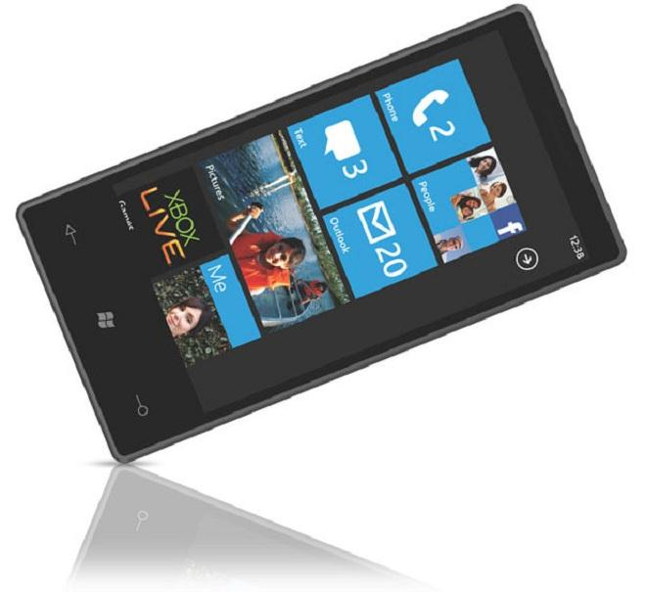

Windows Phone 7
Christophe Peerens
http://www.neomytic.be

Slide 2
Agenda
Windows Phone 7
Marketplace
Tips and tricks When Making Your Application
Mango
Call To Action
Q&A

Slide 3
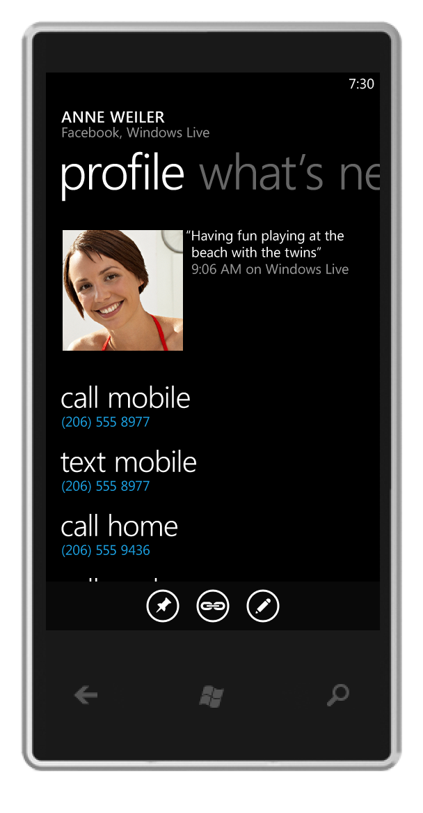
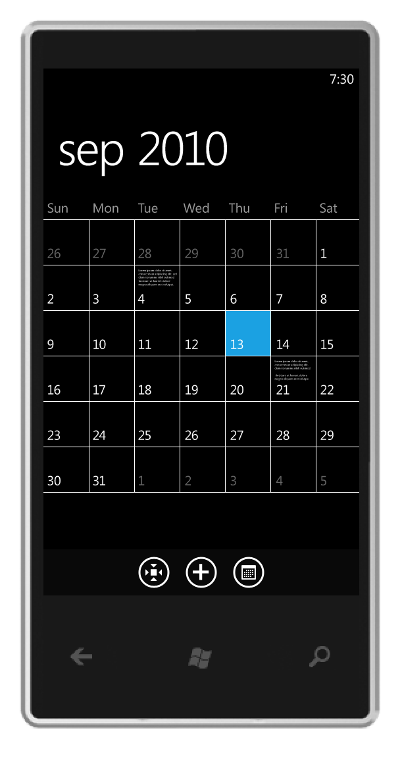
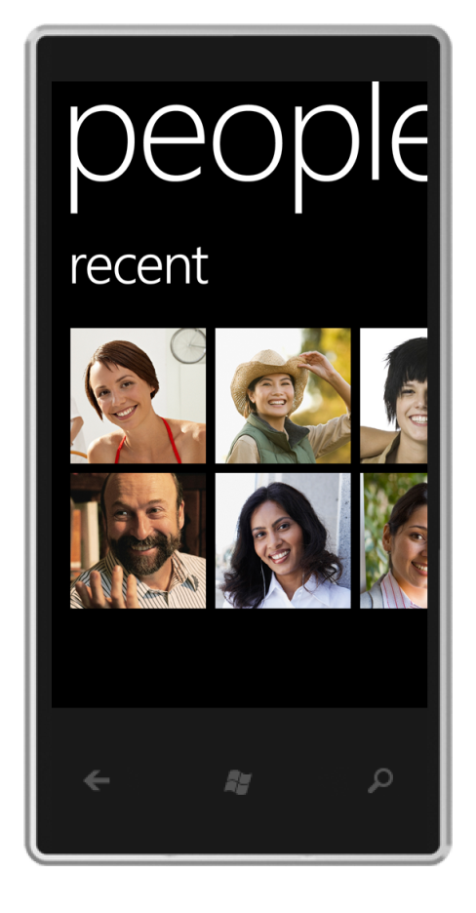
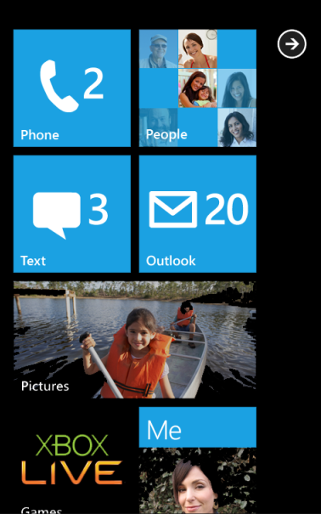
Windows Phone 7

Slide 4
Introduction
Windows Phone 7
Windows Phone 7.1
Windows Phone 7.5
  Announcement MIX11(April)
  Tools (May)
  OS Update (???July???)

Slide 5
Marketplace Goals
High Quality Experiences
Content Choice
Purchase Confidence
Innovation
Discoverability
Monetization

Slide 6
Marketplace

Slide 7
Marketplace statistics
More than 15000 certified applications and games
About 100 news apps per day
61% Paid, 39% Free
About 40K developers registered
About 7300 developers have submitted 1 or more apps
12 Download per User per Month
10% Conversion rate from Trial to Paid Purchase

Slide 8
Marketplace for developers
Several bug fixes in the process
98% of support inquiries are responded within 24 hours
Free apps limits from 5 to 100 per year
App Hub Annual Membership price from 99 to 75€
Mango
  Allow Beta users through
    List of tester
    Private deeplink
  Private distribution

Slide 9
Marketplace for users
Mango
  Improved discoverability
    M-rated Games
    Improved Search by key, content type, …
  New layout (Pivot style)
  Improved App List & installation feed back

Slide 10
Tips and tricks When Making Your Application
Some points to think about when designing/creating your application

Slide 11
Use Trial API
70x More Download
10% trial-to-Paid conversion rate
7x higher sales

Slide 12
Use Trial API - Tips and Tricks
Don’t give away too much value
Make the trial experience compelling
Time or capability based trials work
Incorporate Ads in the Trial version

Slide 13
Use Live Tiles w/Push
Live Tiles Increase
  Use frequency
  Duration of Session Use
  User Satisfaction
Equaling More Impression

Slide 14
Use Lives Tiles w/Push - Tips and Tricks
Indicate « Live Tile » in description
Add relevant and creative push content
Make it Stand Out
Mango
  Can update the Tiles in background

Slide 15
Ad Control w/Location
For Free or trial apps
https://pubcenter.microsoft.com
http://advertising.microsoft.com/mobile-apps

Slide 16
Ad Control w/Location – Tips and Tricks
Think about a paid app that will be used by 1 user, and an free app that will be used by 70 user that will generate ads money!
Add location services for ad targeting

Slide 17
Publish (and Localize) Globally
Less than 15% of English apps are localized into FIGS languages
Most customers prefer and download apps in their local language
Mango
  Support Dutch
  And other languages

Slide 18
Publish (and Localize) Globally – Tips and Tricks
Localize your meta-data and app with native speakers, if possible
Add new languages in single Xap via updates

Slide 19
Mango
Microsoft’s MIX11 developer conference in Las Vegas announced…

Slide 20
Mango Key features
IE9 support leverages HTML5 rendering engine similar to the one on desktop. That means hardware accelerated HTML5 Audio and Video (H264) playback is supported without the need for plug-ins
Application specific Background Agents scheduled by OS in a battery friendly manner. Applications can write their own agents which can be scheduled by OS.
16 additional new languages
Multiple live tiles for each application; you will be able to take a specific aspect of the application and pin it as a tile.
Applications can be submitted from 38 counties during Mango time frame.
User experience enhancements through “search” enabling of installed applications. Useful when you install a lot of applications.
Raw camera feed access to applications
In-memory local SQL database for ease of data intensive applications.

Slide 21
Mango Multi-tasking
Fast Application Resume
  Ability to resume applications that the user has recently used
  Apps stay in memory unless memory is needed for other apps
Background Agents
  Ability to run your code in the background
  Audio, Timed or on Idle
Notifications
  Ability to create alarms and reminders
Background Transfer Service
  Application can queue up transfers in the background

Slide 22

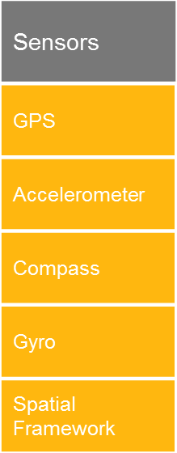

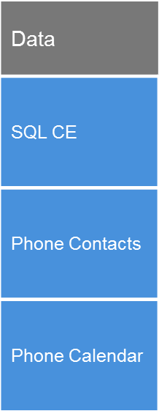
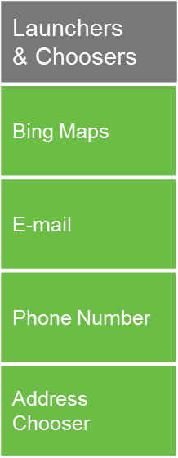

Integrating with the phone

Slide 23
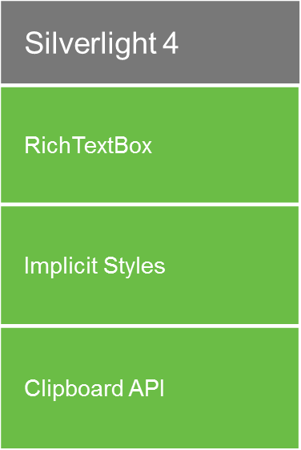
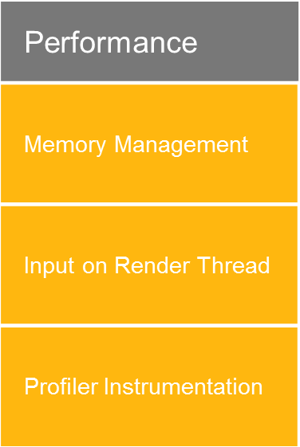

Silverlight Investments

Slide 24
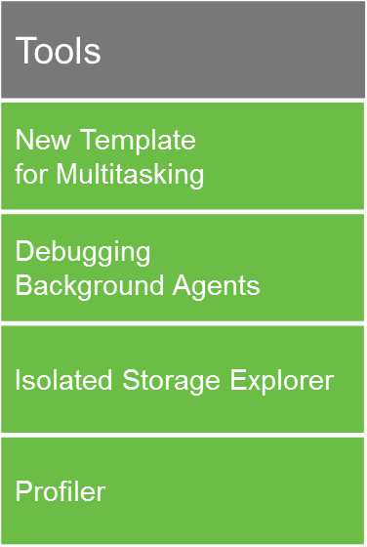
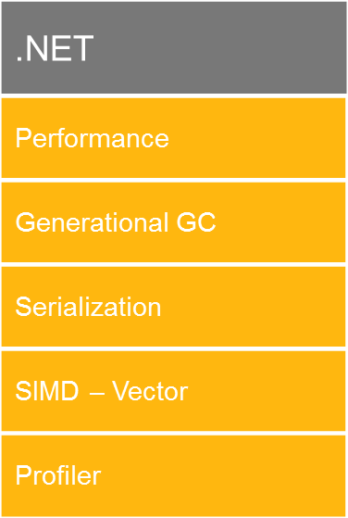
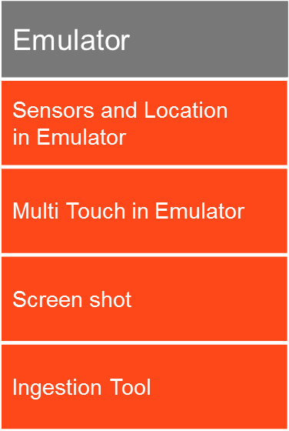
Tools Investments

Slide 25
Call to Action
When developing a Windows Phone 7 app now, think on the extensions that Mango will provides to your app
Tools should be available in May

Slide 26
Q&A

