Slide 1


Pour que le code lui-aussi soit agile
la programmation
orientée aspects
par Gaël Fraiteur

Slide 2
Agenda
The Problem with Conventional Programming
Show Case 1 – A Simple Aspect
What is AOP?
The Value of AOP
Comparing AOP Frameworks
Show Case 2 – An Advanced Aspect

Slide 3
The Problem with
Conventional Programming
Part 1

Slide 4
In the beginning
there was nothing.
public class CustomerProcesses
{
}

Slide 5
Customer said: let there be business value.
public class CustomerProcesses
{
public bool ReserveBook( int bookId, int customerId )
{
Book book = Book.GetById( bookId );
Customer customer = Customer.GetById( customerId );
book.RentedTo = customer;
customer.AccountLines.Add(
string.Format( "Rental of book {0}.", book ), book.RentalPrice );
customer.Balance -= book.RentalPrice;
}
}
And there was business code.

Slide 6
internal class CustomerProcesses
{
private static readonly TraceSource trace =
new TraceSource( typeof (CustomerProcesses).FullName );
public void RentBook( int bookId, int customerId )
{
trace.TraceInformation(
"Entering CustomerProcesses.CreateCustomer( bookId = {0},
customerId = {1} )",
bookId, customerId );
try
{
Book book = Book.GetById( bookId );
Customer customer = Customer.GetById( customerId );
book.RentedTo = customer;
customer.AccountLines.Add(
string.Format( "Rental of book {0}.", book ), book.RentalPrice );
customer.Balance -= book.RentalPrice;
trace.TraceInformation(
"Leaving CustomerProcesses.CreateCustomer( bookId = {0}, customerId = {1} )",
bookId, customerId );
}
catch ( Exception e )
{
trace.TraceEvent( TraceEventType.Error, 0,
"Exception: CustomerProcesses.CreateCustomer(
bookId = {0}, customerId = {1} ) failed : {2}",
bookId, customerId, e.Message );
throw;
}
}
}
Testers said:
Let there be logging
And there was logging code.

Slide 7
internal class CustomerProcesses
{
private static readonly TraceSource trace =
new TraceSource(typeof(CustomerProcesses).FullName);
public void RentBook(int bookId, int customerId)
{
if (bookId <= 0) throw new ArgumentOutOfRangeException("bookId");
if (customerId <= 0) throw new ArgumentOutOfRangeException("customerId");
trace.TraceInformation(
"Entering CustomerProcesses.CreateCustomer( bookId = {0}, customerId = {1} )",
bookId, customerId);
try
{
Book book = Book.GetById(bookId);
Customer customer = Customer.GetById(customerId);
book.RentedTo = customer;
customer.AccountLines.Add(string.Format("Rental of book {0}.", book),
book.RentalPrice);
customer.Balance -= book.RentalPrice;
trace.TraceInformation(
"Leaving CustomerProcesses.CreateCustomer( bookId = {0},
customerId = {1} )“, bookId, customerId);
}
catch (Exception e)
{
trace.TraceEvent(TraceEventType.Error, 0,
"Exception: CustomerProcesses.CreateCustomer( bookId = {0},
customerId = {1} ) failed : {2}",
bookId, customerId, e.Message);
throw;
}
}
}
Devs said:
Let there be defensive programming
Then
there was precondition checking code.

Slide 8
internal class CustomerProcesses
{
private static readonly TraceSource trace =
new TraceSource(typeof(CustomerProcesses).FullName);
public void RentBook(int bookId, int customerId)
{
if (bookId <= 0)
throw new ArgumentOutOfRangeException("bookId");
if (customerId <= 0)
throw new ArgumentOutOfRangeException("customerId");
trace.TraceInformation(
"Entering CustomerProcesses.CreateCustomer( bookId = {0},
customerId = {1} )“, bookId, customerId);
try
{
for (int i = 0; ; i++)
{
try
{
using (var ts = new TransactionScope())
{
Book book = Book.GetById(bookId);
Customer customer =
Customer.GetById(customerId);
book.RentedTo = customer;
customer.AccountLines.Add(
string.Format("Rental of book {0}.", book),
book.RentalPrice);
customer.Balance -= book.RentalPrice;
ts.Complete();
}
break;
}
catch (TransactionConflictException)
{
if (i < 3)
continue;
else
throw;
}
}
trace.TraceInformation(
"Leaving CustomerProcesses.CreateCustomer(
bookId = {0}, customerId = {1} )",
bookId, customerId);
}
catch (Exception e)
{
trace.TraceEvent(TraceEventType.Error, 0,
"Exception: CustomerProcesses.CreateCustomer( bookId = {0},
customerId = {1} ) failed : {2}",
bookId, customerId, e.Message);
throw;
}
}
}
Let there be safe concurrent execution.
And there was transaction handling code.

Slide 9
internal class CustomerProcesses
{
private static readonly TraceSource trace =
new TraceSource(typeof(CustomerProcesses).FullName);
public void RentBook(int bookId, int customerId)
{
if (bookId <= 0) throw new ArgumentOutOfRangeException("bookId");
if (customerId <= 0)
throw new ArgumentOutOfRangeException("customerId");
try
{
trace.TraceInformation(
"Entering CustomerProcesses.CreateCustomer(
bookId = {0}, customerId = {1} )",
bookId, customerId );
try
{
for ( int i = 0;; i++ )
{
try
{
using ( var ts = new TransactionScope() )
{
Book book = Book.GetById( bookId );
Customer customer = Customer.GetById( customerId );
book.RentedTo = customer;
customer.AccountLines.Add(
string.Format( "Rental of book {0}.", book ),
book.RentalPrice );
customer.Balance -= book.RentalPrice;
ts.Complete();
}
break;
}
catch ( TransactionConflictException )
{
if ( i < 3 )
continue;
else
throw;
}
}
trace.TraceInformation(
"Leaving CustomerProcesses.CreateCustomer(
bookId = {0}, customerId = {1} )",
bookId, customerId );
}
catch ( Exception e )
{
trace.TraceEvent( TraceEventType.Error, 0,
"Exception: CustomerProcesses.CreateCustomer(
bookId = {0}, customerId = {1} ) failed : {2}",
bookId, customerId, e.Message );
throw;
}
}
catch ( Exception e )
{
if (ExceptionManager.Handle(e)) throw;
}
}
}
Let there be user-friendly error messages.
And there was exception handling code.

Slide 10


AKSEL BACHMEIER
architect
YOHJI YAMAMOTO
customer

Slide 11
Why do we write ugly code?
We want a nice separation of concerns
(assembly > namespace > class > method)
OOP forces us to write crap!
  Code Scattering
  Code Tangling
  Code Coupling
Layer 1
Layer 2

Slide 12
Non-Functional Requirements
Security
Exception Handling
Tracing
Monitoring
Transaction
Data Binding
Thread Sync
Caching
Validation
Cross-Cutting Concerns

Slide 13
Encapsulating
Infrastructure Concerns?

Slide 14
Aspects!

Slide 15
Strengthen Applications
With Aspects
Part 2 – Live Demo

Slide 16
The Idea Behind AOP
Part 3

Slide 17

Cross-Cutting Concerns
Problem Domain
Solution Domain
Separation of
Concerns

Slide 18
What is AOP?
An extension of (not an alternative to) OOP that addresses the issue of cross-cutting concerns by providing a mean to:
  Encapsulate cross-cutting concerns
  into Aspects = collection of transformations of code
  Apply aspects to elements of code

Slide 19
15 Years of AOP History
1997
2003
2007-2008
2010
2001
AspectJ released to the Eclise OSS community
Spring Framework 1.0
AOP coined by Gregor Kiczales (Xerox PARC)
AspectJ published;
First AOSD Conference
PostSharp 1.0
PostSharp 1.5
PostSharp 2.0
Build up of Interface21, later SpringSource, around IoC and AOP
2009
SpringSource acquired by VMWare, $400M
1994-1996
First efforts on program transformation
Works Begins on PostSharp
JBoss AOP
.NET 1.0
2004
WebSphere AOP
AJDT
SAP Enhancement Framework
ALCOB (AOP for COBOL)
Research Years
Hype Years
Productivity Years

Slide 20
Why You Should Care
The benefits of
aspect-oriented programming

Slide 21
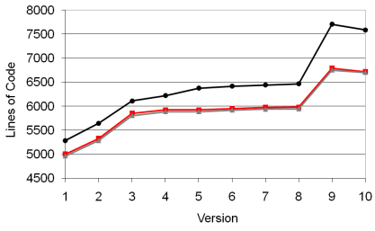
Reduce the number of LOC
The benefits of aspect-oriented programming
Less code to write =
fewer defects
Less code to read = easier maintenance
AOP
On the Impact of Aspectual Decompositions on
Design Stability: An Empirical Study
Phil Greenwood, Thiago Bartolomei, Eduardo Figueiredo, Marcos Dosea,
Alessandro Garcia, Nelio Cacho, Cláudio Sant’Anna, Sergio Soares,
Paulo Borba, Uirá Kulesza, and Awais Rashid
ECOOP 2007 – OBJECT-ORIENTED PROGRAMMING (Springer)

Slide 22
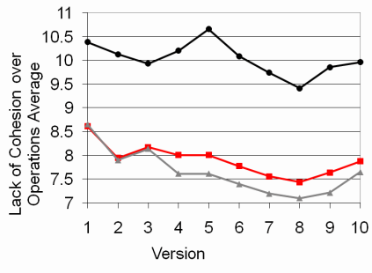
Improve cohesion & stability
The benefits of aspect-oriented programming
Reduce code scattering
Reduce code tangling
Improve the
open/closed principle
AOP
On the Impact of Aspectual Decompositions on
Design Stability: An Empirical Study
Phil Greenwood, Thiago Bartolomei, Eduardo Figueiredo, Marcos Dosea,
Alessandro Garcia, Nelio Cacho, Cláudio Sant’Anna, Sergio Soares,
Paulo Borba, Uirá Kulesza, and Awais Rashid
ECOOP 2007 – OBJECT-ORIENTED PROGRAMMING (Springer)

Slide 23
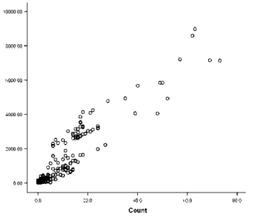
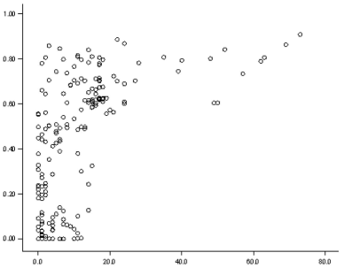
Reduce the number of defects
The benefits of aspect-oriented programming
Less code = Fewer defects
Less scattering = Fewer defects
Size of feature
Scattering of feature
LOC in Concern
Number of defects in feature
Number of defects in feature
Do Crosscutting Concerns Cause Defects?
Marc Eaddy, Student Member, IEEE, Thomas Zimmermann, Student Member, IEEE,
Kaitlin D. Sherwood, Vibhav Garg, Gail C. Murphy, Member, IEEE Computer Society,
Nachiappan Nagappan, Member, IEEE, and Alfred V. Aho, Fellow, IEEE
IEEE TRANSACTIONS ON SOFTWARE ENGINEERING, VOL. 34, NO. 4, JULY/AUGUST 2008

Slide 24
Improve teamwork
The benefits of aspect-oriented programming
System Developers Prepare Aspects
UI/Business Developers Use Aspects
n
1
I understand provisioning processes better than anyone in this company,
I master multithreading better than anyone on earth
Picture © Darren Rogers and chatwoodsfp (Flicker)

Slide 25

Reduce Development Cost
The benefits of aspect-oriented programming
Better economies of scale
Improved team capability
$$\text{Effort}=A×{\left(\text{Size}\right)}^{E}×\prod_{i=1}^{n}{M_{i}}$$
Fewer Lines of Code
Short-term disadvantages:
Higher technology risk
Lower technology experience
COSYSMO: A Systems Engineering Cost Model
Barry W. Boehm, Donald J. Reifer, Ricardo Valerdi
University of Southern California – Center for Software Engineering
Submitted for the 1st Annual Conference on Systems Integration

Slide 26
Comparing Aspect Frameworks
Part 4

Slide 27
What to compare?
Comparing Aspect Frameworks
Expressive
Supported
Non-Invasive
Framework
Productive
Robust
Dynamic

Slide 28
Static vs Dynamic AOP
Comparing Aspect Frameworks
Spring AOP
Spring.NET
Castle
MS Unity/PIAB
(MEF)
(WCF)
(ASP.NET MVC)
PostSharp
AspectJ
Build-Time
Run-Time

Slide 29

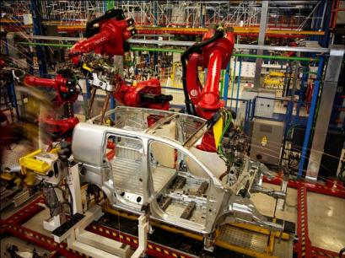

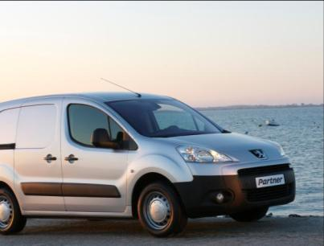
Build-Time AOP
1. Source
2. Compiler
3. PostSharp
4. Run Time
AOP is an approach to programming,
not a technology.

Slide 30
Proxy-Based AOP
AO Infrastructure
Consumer Object
Proxy
Enhanced Object
Aspects
Proxies: JIT Emitted (interface or deriving), Transparent

Slide 31
Static vs Dynamic AOP
Comparing Aspect Frameworks
Spring AOP
Spring.NET
Castle
MS Unity/PIAB
(MEF)
(WCF)
(ASP.NET MVC)
PostSharp
AspectJ + AJDT
LinFu
Build-Time:
Very Expressive
Robust Model
IDE Integration
Not Invasive
Static
Hybrid
Run-Time:
Less Expressive
Brittle Model
No IDE Integration
Invasive
Dynamic

Slide 32
My Own Summary
Comparing Aspect Frameworks
Aspects on Service Boundaries:
use your favorite application framework.
Aspects on Ordinary and GUI Objects: use PostSharp.
You can mix PostSharp with your favorite application framework!

Slide 33
Summary

Slide 34
We need Aspects!

Slide 35
We have
great frameworks!
and PostSharp happens to be the best in .NET :).

Slide 36
Questions

Slide 37
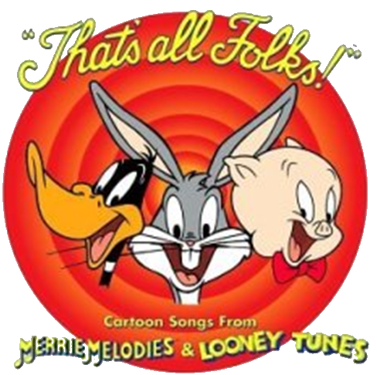

http://www.sharpcrafters.com/
gael@sharpcrafters.com

